Slide 1
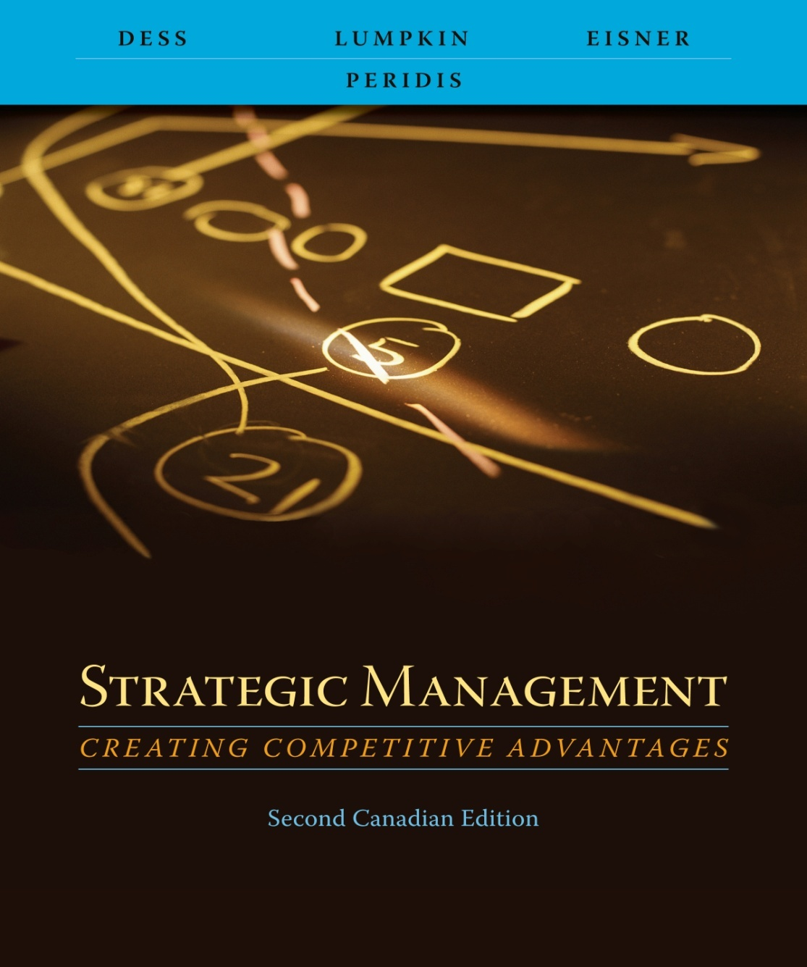
Chapter 7
International Strategy: Creating Value in
Global Markets

Slide 2
Learning Objectives
After reading this chapter, you should have a good understanding of:
  The importance of international expansion as a viable diversification strategy.
  The sources of national advantage.
  The motivations (or benefits) and the risks associated with international expansion.
  The two opposing forces—cost reduction and adaptation to local markets—that firms face when entering international markets.
  The advantages and disadvantages associated with each of the four basic strategies for achieving competitive advantage in global markets: international, global, multi-domestic, and transnational.
  The six basic types of entry strategies and the relative benefits and risks associated with each of them.

Slide 3
The Global Economy: A Grief Overview
Opportunities and risks when firms diversify abroad
  Trade across nations will exceed trade within nations
  Rise of market capitalism around the world
  Transfer of money from rich to poor countries
    Equity
    Bond investments
    Commercial loans

Slide 4
The Global Economy: A Grief Overview
Opportunities and risks when firms diversify abroad
  Economies of East Asia have grown rapidly, but little progress in the rest of the world
  Poor education levels in many countries
  Failure to manage broader economic factors in some countries
    Interest rates
    Inflation
    Unemployment

Slide 5
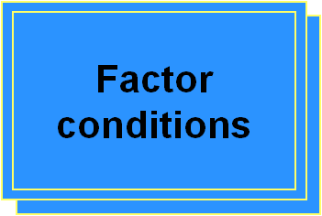
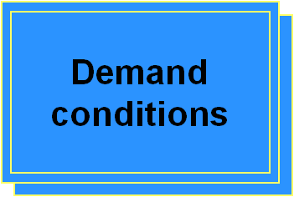

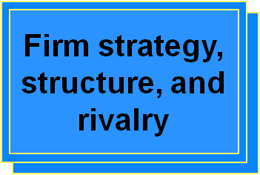
Factors Affecting a Nation’s Competitiveness

Slide 6
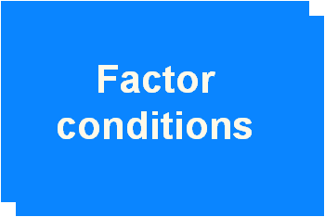
Factors Affecting a Nation’s Competitiveness
  Nation’s position in factors of production
    Skilled labour
    infrastructure
To achieve competitive advantage, factors of production must be created
  Industry specific
  Firm specific
  Pool of resources at a firm’s or country’s disposal is less important than the speed and efficiency with which the resources are deployed

Slide 7
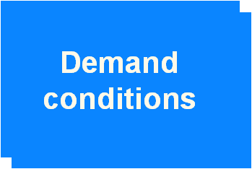
Factors Affecting a Nation’s Competitiveness
  Nature of home-market demand
    Industry’s product
    Industry’s service
Demands that consumers place on an industry for goods and services
  Demanding consumers push firms to move ahead of companies from other nations
  Demanding consumers drive firms in a country to
    Meet high standards
    Upgrade existing products and services
    Create innovative products and services

Slide 8

Factors Affecting a Nation’s Competitiveness
  Presence or absence in the nation of internationally competitive
    Supplier industries
    Other related industries
  Enable firms to manage inputs more effectively
    Strong supplier base adds efficiency to downstream activities
    Competitive supplier base lets a firm obtain inputs using cost-effective, timely methods
  Allow joint efforts among firms
  Create the probability that new entrants will enter the market

Slide 9
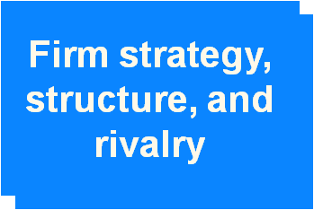
Factors Affecting a Nation’s Competitiveness
  Conditions in the nation governing how companies are
    Created ; Organized; Managed
  Nature of domestic rivalry
Rivalry is intense in nations with conditions of
  Strong consumer demand ;Strong supplier bases
  High new entrant potential from related industries
Competitive rivalry increases the efficiency with which firms develop, market, and distribute products and services within the home country
Competitive rivalry increases the efficiency with which firms
  Develop within the home country
  Market within the home country
  Distribute products and services within the home country

Slide 10
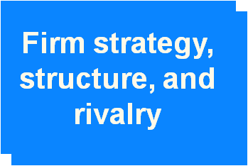
Firm Strategy, Structure and Rivalry
Competitive rivalry increases the efficiency with which firms
  Develop within the home country
  Market within the home country
  Distribute products and services within the home country
Domestic rivalry provides a strong impetus for firms to
  Innovate
  Find new sources of competitive advantage
Domestic rivalry forces firms to look beyond national borders for new markets

Slide 11





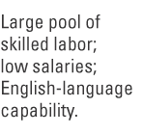


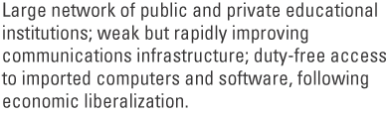
Porter’s Diamond of National Advantage: As Applied to India
Adapted from Exhibit 7.1 India’s Virtual Diamond in Software

Slide 12
A Company’s Motivation for International Expansion
Increase the size of potential markets
Attain economies of scale
Extend the life cycle of a product
Optimize the physical location for every activity in its value chain
  Performance enhancement
  Cost reduction
  Risk reduction

Slide 13
Potential Risks of International Expansion
Political and economic risk
  Social unrest
  Military turmoil
  Demonstrations
  Violent conflict and terrorism
  Laws and their enforcement
Currency risks: Currency exchange fluctuations
Management risks : Culture ; Customs; Language
  Income levels
  Customer preferences
  Distribution system

Slide 14
Two Opposing Pressures: Reducing Costs and Adapting to Local Markets
Strategies that favor global products and brands
  Should standardize all of a firm’s products for all of their worldwide markets
  Should reduce a firm’s overall costs by spreading investments over a larger market
  Are based on three assumptions
    Customer needs and interests worldwide are becoming more homogeneous
    People (worldwide) prefer lower prices at high quality
    Economies of scale in production and marketing can be achieved through supplying global markets

Slide 15
Two Opposing Pressures: Reducing Costs and Adapting to Local Markets
But those three assumptions may not always be true
  Product markets vary widely between nations (customer needs and interests?)
  In many product and service markets there appears to be a growing interest in multiple product features, quality and service (preference for low price?)
  Technology permits flexible production, cost of production may not be critical to product cost, and firm’s strategy should not be product-driven

Slide 16
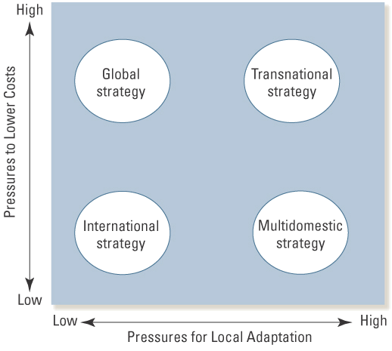
Opposing Pressures and Four Strategies
Exhibit 7.5 Opposing Pressures and Four Strategies

Slide 17
International Strategy
Pressure for both local adaptation and low costs are rather low
Different activities in the value chain have different optimal locations
Susceptible to higher levels of currency and political risks

Slide 18
Global Strategy
Competitive strategy is centralized and controlled largely by corporate office
Emphasizes economies of scale
Advantages
  Larger production plants
  Efficient logistics and distribution networks
  Supports high levels of investment in R&D
  Standard level of quality throughout the world

Slide 19
Global Strategy
  Disadvantages
  Concentration on scale-sensitive resources and activities in one or few locations leads to higher transportation and tariff costs
  Activity is isolated from targeted markets
  The rest of the firm becomes dependent on that geographically isolated location

Slide 20
Multidomestic Strategy
Emphasis is differentiating products and services to adapt to local markets
Authority is more decentralized
Risks include
  Increased cost structure
  Potential problems with local adaptations
  Finding optimal degree of local adaptation is difficult

Slide 21
Transnational Strategy
Optimization of tradeoffs associated with efficiency, local adaptation, and learning
Firm’s assets and capabilities are dispersed according to the most beneficial location for a specific activity
Avoids the tendency to either
  Concentrate activities in a central location
  Disperse them across many locations to enhance adaptation
Unique risks and challenges
  Choice of an “optimal” location cannot guarantee that the quality and cost of factor inputs will be optimal
  Knowledge transfer can be a key source of competitive advantage, but it does not take place automatically

Slide 22
Strengths and Limitations of Various Strategies
Strategy Strengths Limitations
International
Leverage and diffuse parent’s knowledge and core competencies.
Lower costs because of less need to tailor products and services.
Greater level of worldwide coordination
Limited ability to adapt to local markets.
Inability to take advantage of new ideas and innovations occurring in local markets.
Global
Strong integration across various businesses.
Standardization leads to higher economies of scale which lowers costs.
Helps to create uniform standards of quality throughout the world.
Limited ability to adapt to local markets.
Concentration of activities may increase dependence on a single facility.
Single locations may lead to higher tariffs and transportation costs.
Exhibit 7.6 Strengths and Limitations of Various Strategies

Slide 23
Strengths and Limitations of
Various Strategies
Strategy Strengths Limitations
Multi-domestic
Ability to adapt products and services to local market conditions.
Ability to detect potential opportunities for attractive niches in a given market, enhancing revenue.
Less ability to realize cost savings through scale economies.
Greater difficulty in transferring knowledge across countries.
May lead to “over-adaptation” as conditions change.
Transnational
Ability to attain economies of scale.
Ability to adapt to local markets.
Ability to locate activities in optimal locations.
Ability to increase knowledge flows and learning.
Unique challenges in determining optimal locations of activities to ensure cost and quality.
Unique managerial challenges in fostering knowledge transfer.
Exhibit 7.6 Strengths and Limitations of Various Strategies

Slide 24






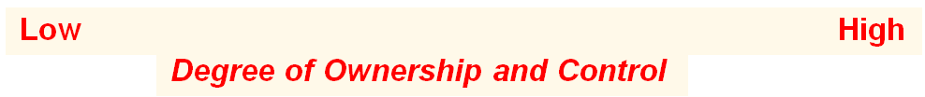
Entry Modes of International Expansion
High
Low
Extent of Investment Risk
Adapted from Exhibit 7.7 Entry Modes for International Expansion

Slide 25
Exporting
Relatively inexpensive way to enter foreign market
Minimal risk
Successful distributors
  Carry product lines that complement the multinational’s products
  Behave as if they are business partners with the multinationals.
  Invest in training, information systems, and advertising and promotion

Slide 26
Licensing and Franchising
Franchisor receives a royalty or fee
Franchisee gets to use trademark, patent, trade secret or other valuable intellectual property
Disadvantages
  Loss of control over its product
  Licensee may become a competitor
  Threat to brand name and reputation of products
Advantages
  Limited risk exposure
  Expanded revenue base

Slide 27
Strategic Alliances and Joint Ventures
Partnerships that enable firms to share risks and potential revenues and profits
Partners
  gain exposure to new knowledge and technologies
  Develop core competencies that can lead to competitive advantages
  Gain information on local markets conditions

Slide 28
Strategic Alliances and Joint Ventures
Partnerships that enable firms to share risks and potential revenues and profits
Risks
  Needs to be clearly defined strategy supported by both partners
  Needs to be clear understanding of capabilities and resources that will be central to the partnership
  Must be trust between partners

Slide 29
Wholly Owned Subsidiaries
Business owned by only one multinational company
  Acquire an existing company in the home country
  Develop a totally new operation (greenfield venture)
  Most expensive and risky of all global entry strategies
  Greatest control over all activities

